Slide 1
Ticketmaster Event Planning Analysis
Eva Murdock, Daniel Hill, Toby Guenthner, Alexa Hildebrand, Fernando Fonseca

Slide 2
Table of contents
01
03
02
04
Our data
Our analyses
Our process
Our next steps

Slide 3
Our Data
Ticketmaster API
Event and sports information
Location, pricing, category, time
Each set of API calls: top 1000 most relevant events
How does the day of the week affect ticket pricing?

Slide 4



AWS CDK Process
Create IAM policies to give permission to services
Two S3 buckets: one for data, one for glue scripts
Attach glue role to each of the buckets for read/write access
Deploy python scripts to scripts bucket
Initialize glue workflow with a job and a trigger
Trigger runs daily
Fetches API key from AWS secret manager
Glue job hits API until denial, converts JSON data to tabular
Creates pandas dataframe that is put into S3 bucket as csv
Graph creation scripts using Cloud9, puts images back in data bucket
Notes:
Daniel

Slide 5
Interactive Map!
Notes:
eva

Slide 6
Our Hypothesis
Is there a cheaper day to watch different type of events?
We think: No matter what event, tickets will tend to be cheaper during weekdays and more expensive on Fridays and Saturday
Notes:
Fernando
Something about we wanting to analyze if prices for events vary on different days of the week, for different types of events??...
So from there we were interested in deciding what days of the week are the cheapest and less competitive days to find tickets days with a really high max might indicate more interest in the game based on supply demand prices would go up. And then proceed to our analysis

Slide 7
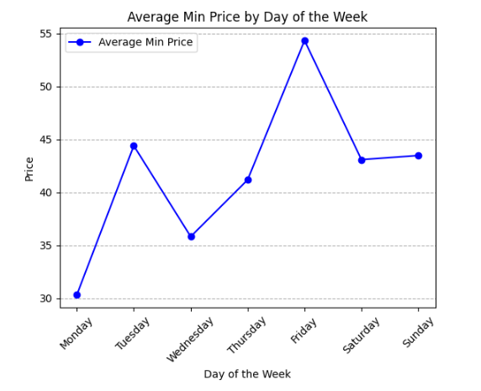
Event Ticket Prices for all Events
Notes:
Fernando
Max: red
Min: blue

Slide 8
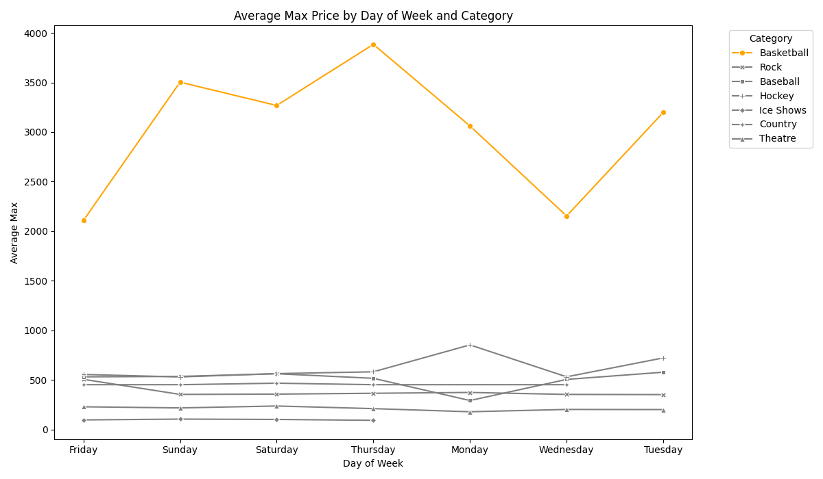
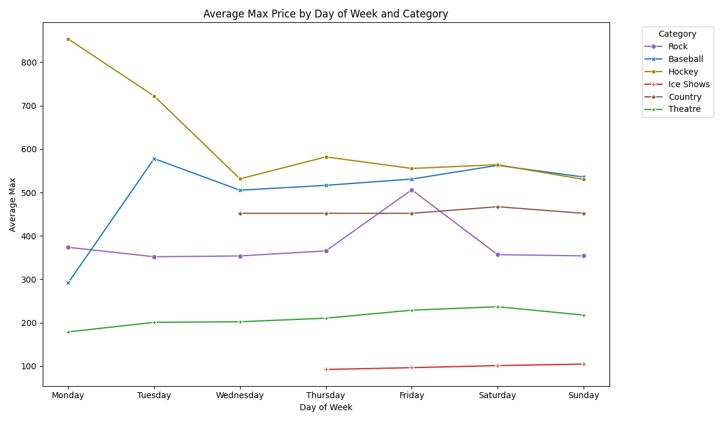
Average max price per day per category
Event Ticket Prices by Category
Notes:
Eva
Basketball - way higher prices than rest so took out
Right graph - hockey has huge peak on monday
Rock peaks friday
Rest kind of consistent

Slide 9
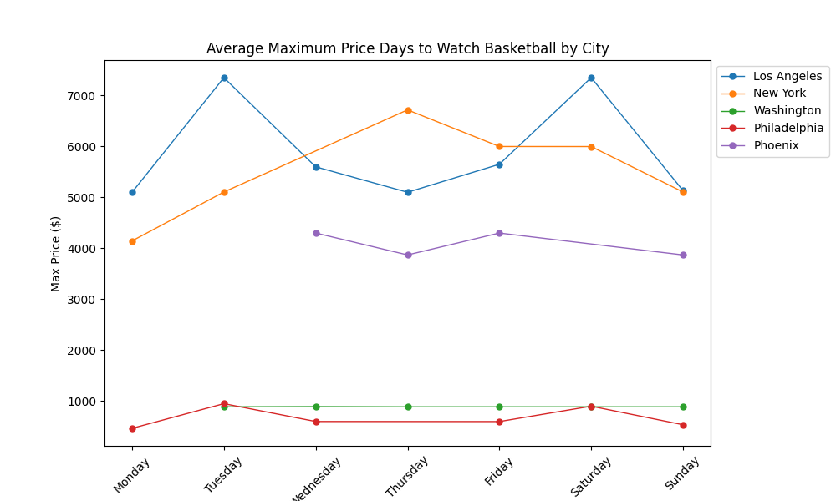
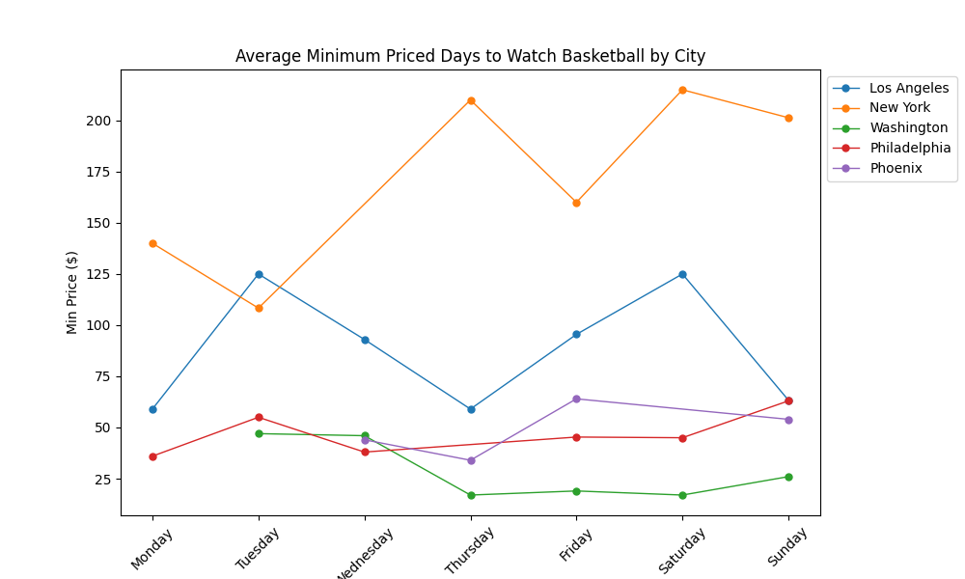
Best Days to watch Basketball
Notes:
Alexa
Seeing game in LA go on monday, thursday, sunday (NOT tuesday/saturday)

Slide 10
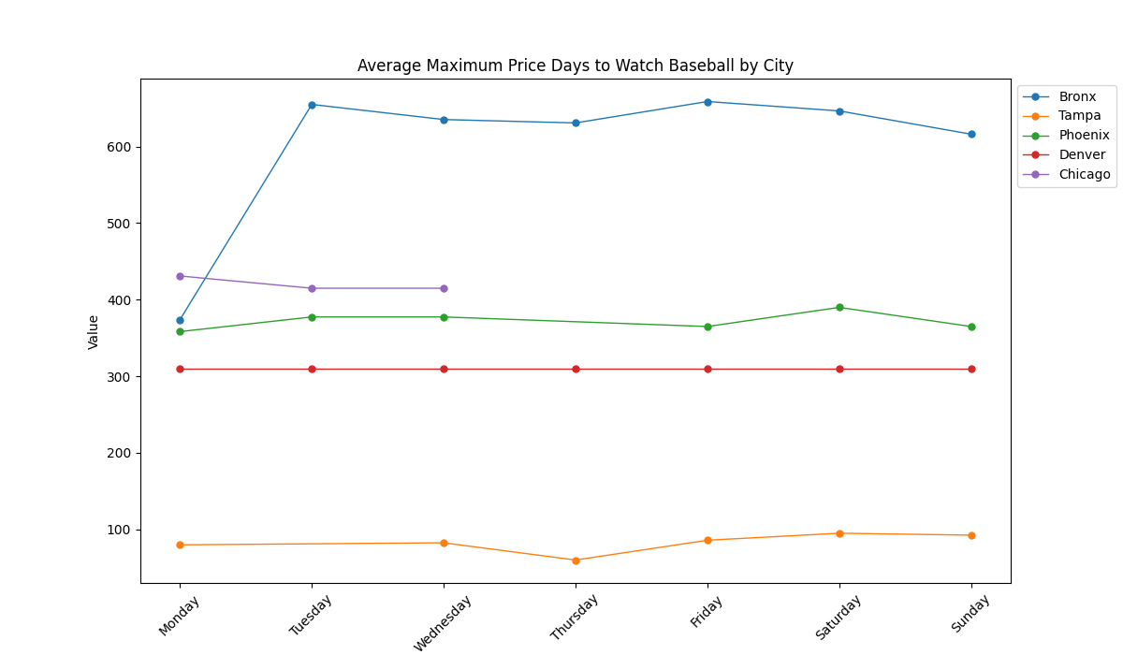
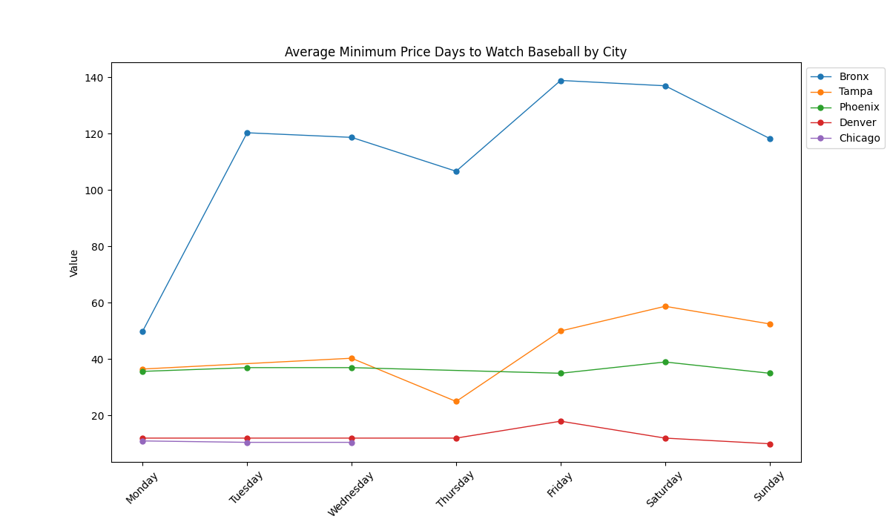
Baseball Ticket Prices by City
Baseball: Average min price per day per city
Notes:
Alexa
Same analysis for baseball - spring training (in fl and az)
Not a lot of variation based on day of week - so many games in general
Maybe dip on thursday and peak on saturday but not enough to change your decision
Location matters more - Bronx is yankees

Slide 11
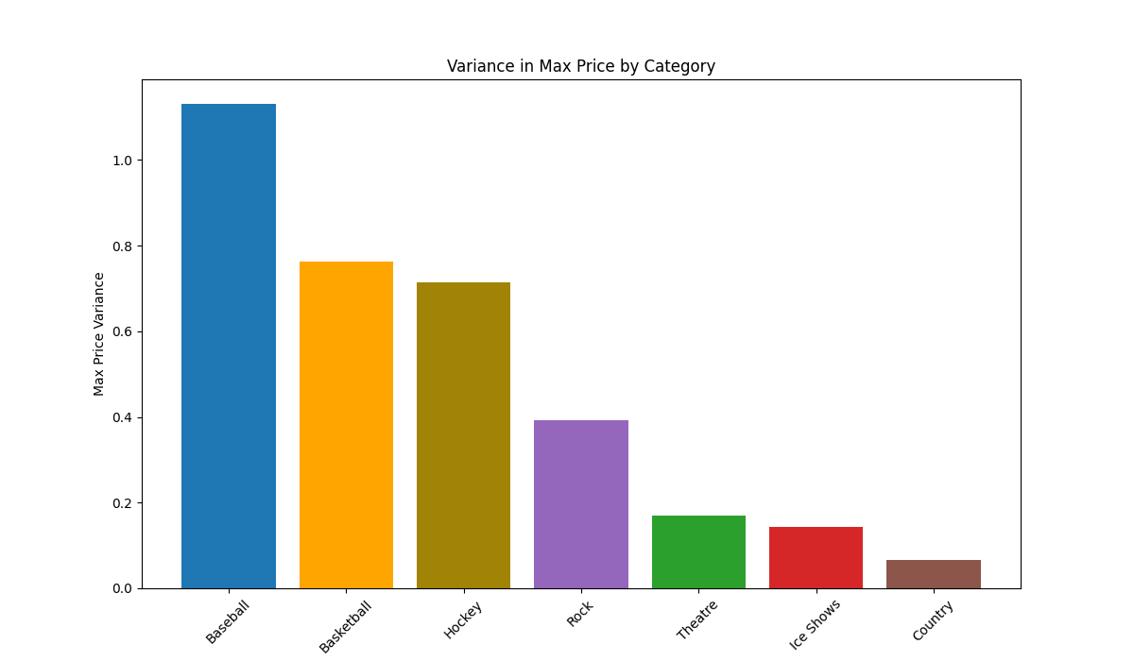
Max Ticket Price Variance by Category
Notes:
Alexa
Same analysis for baseball - spring training (in fl and az)
Not a lot of variation based on day of week - so many games in general
Maybe dip on thursday and peak on saturday but not enough to change your decision
Location matters more - Bronx is yankees

Slide 12
Our Conclusion
It’s hard to say.
We need to do tests of statistical significance and collect more data.

Slide 13
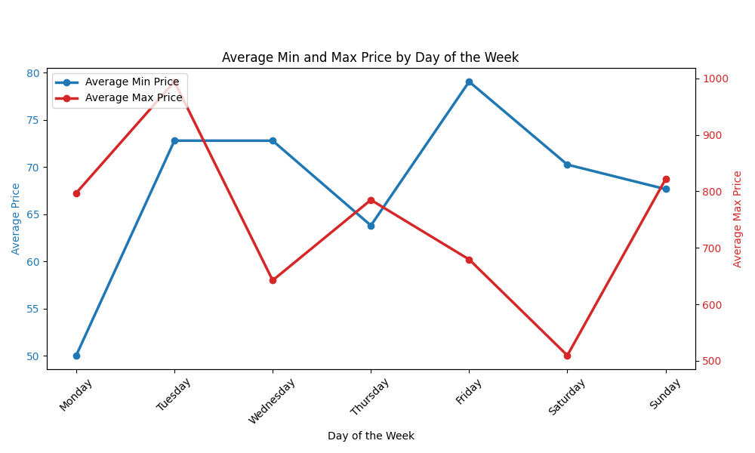
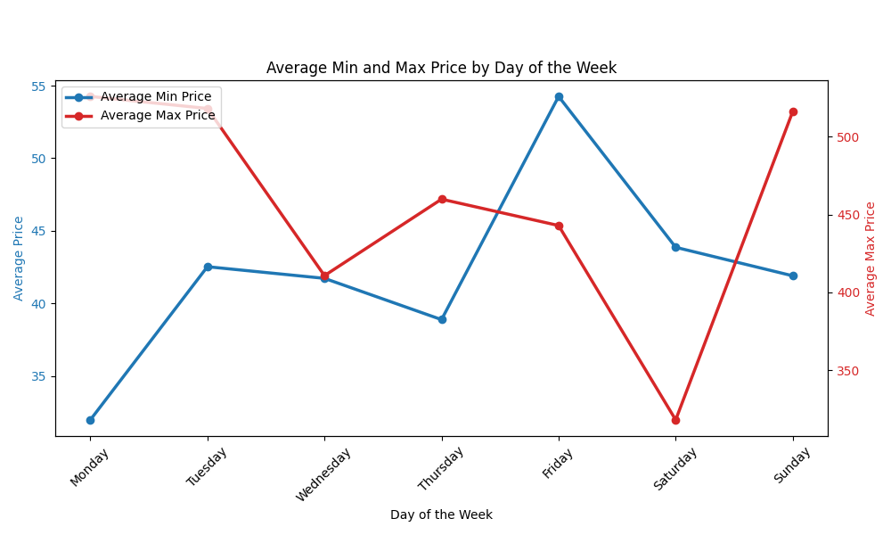
Today
Two Days Ago

Slide 14
Our Next Steps
Refine our Results
Data Engineering
Update and revise our graphs based on the feedback from our class; Further analysis
Change our automatic updating- rather than a complete refresh, append new data
Notes:
From here we can also mention we want to look at if a city having multiple events affects the price for all events that day - within the same category and events across multiple categories

Slide 15
Thanks!

